Slide 1
Enhancing Advanced Analytics and Leadership Skills
Presenters:
Keiko Toma, Head of Analytics
Charlotte Atherden, Analyst
Contributors:
Elodie Hudson, Senior Analytical Lead
Laura Birks, Senior Analyst
Data & Analytics (South East)
england.datasouth@nhs.net
Notes:
Audience participation: Have you ever felt like you couldn't make time for L&D or that your allocated L&D time keeps getting pushed back?

Slide 2

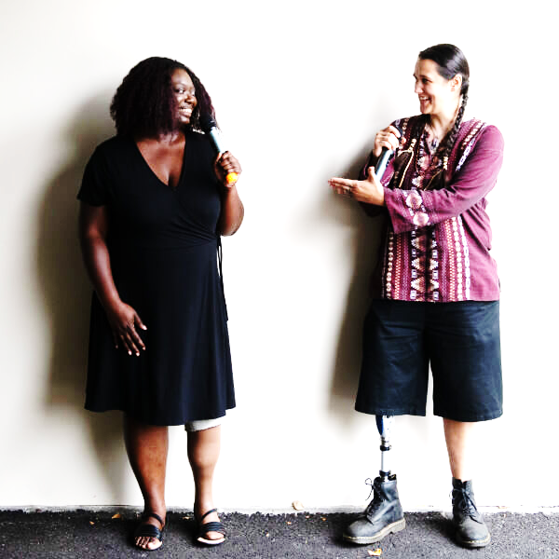

Making Learning Work for You and Your Team
We’re here to share how our team managed to level up our advanced analytics and leadership skills, while keeping up with the day job.
By the end of this session, we hope you’ll:
Understand how we upskill our analyst team to deliver advanced analysis whilst meeting tight deadlines
Feel confident that an L&D programme is achievable and adaptable for everyone
Take away small actionable tasks toward upskilling for yourself and your team and unblock sticking points
Disabled And Here
https://www.istockphoto.com/en/photo/portrait-of-a-woman-in-a-wheelchair-gm1348146298-425441731
Notes:
Hand to Keiko

Slide 3


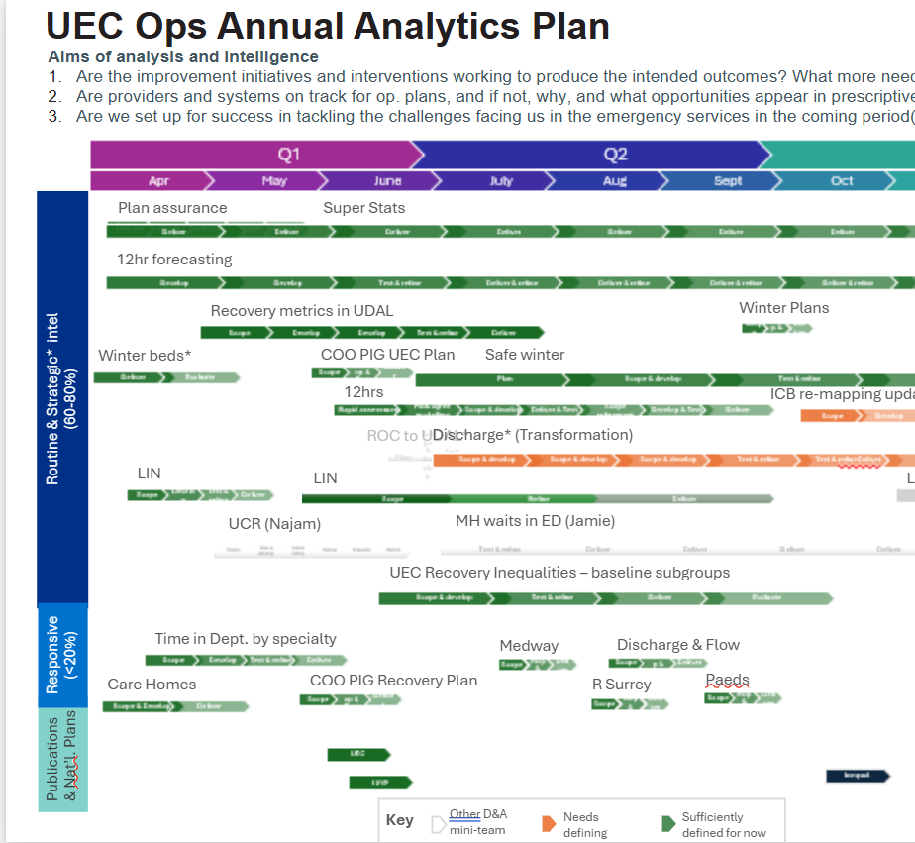


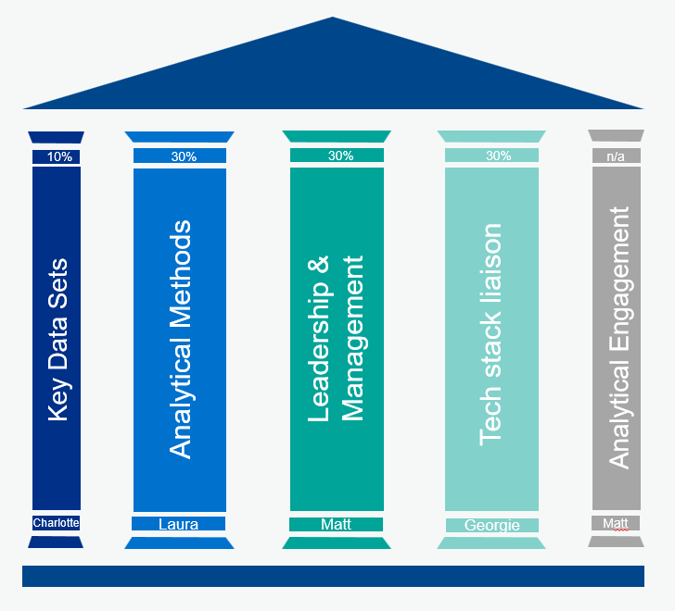
Playbook
Strategic vision
Personal objectives and development plans
Annual analytical plans
Leadership development
Stakeholder management
Programme delivery pillars
Notes:
Keiko
1. Strategic vision: “The team has the right amount of the right skills at the right levels at the right time in order to recruit, retain, and develop highly skilled analysts and achieve the team’s wider vision.” 2. Personal objective: Consistent 5 team-wide objectives in each person’s objectives: Develop skills
Achieve core skills profile and ensure direct reports achieve core skills profile competencies in line with routine dynamic conversations and aspirational talent conversations
Facilitate SE D&A team L&D sessions, without being an expert, at appropriate frequency
Team needs core skills profile, taking account of different roles, programmes, grades, operational context, stakeholder dynamics, and software ecosystem.
5. Stakeholder management: We needed to map stakeholders to understand how to influence their expectations and behaviours about what sorts of analytical work, questions and timelines to expect to allow for advanced analytics and time to learn on the job, 70% of L&D is through deliverables . We started with 12 weeks of training our team on stakeholder influencing techniques with feedback loops. Key enabler to shift from routine perf reporting to adv analytics
6. Pillars: Key Data sets (10%) ; Analytical Methods (30%); Leadership and Management (30%) ; Tech stack (30%) ; Wider Engagement

Slide 4
Strategic vision
“The team has the right amount of the right skills at the right levels at the right time in order to recruit, retain, and develop highly skilled analysts and achieve the team’s wider vision.”
Notes:
1. Strategic vision: “The team has the right amount of the right skills at the right levels at the right time in order to recruit, retain, and develop highly skilled analysts and achieve the team’s wider vision.” 2. Personal objective: Consistent 5 team-wide objectives in each person’s objectives: Develop skills
Achieve core skills profile and ensure direct reports achieve core skills profile competencies in line with routine dynamic conversations and aspirational talent conversations
Facilitate SE D&A team L&D sessions, without being an expert, at appropriate frequency
5. Stakeholder management: We needed to map stakeholders to understand how to influence their expectations and behaviours about what sorts of analytical work, questions and timelines to expect to allow for advanced analytics and time to learn on the job, 70% of L&D is through deliverables . We started with 12 weeks of training our team on stakeholder influencing techniques with feedback loops. Key enabler to shift from routine perf reporting to adv analytics
6. Pillars: Key Data sets (10%) ; Analytical Methods (30%); Leadership and Management (30%) ; Tech stack (30%) ; Wider Engagement

Slide 5
Team-wide personal objective:
Achieve the team’s core skills profile and ensure direct reports achieve core skills profile competencies
Facilitate team learning sessions, without being an expert, at appropriate frequency
Notes:
Hanging off of the strategic vision of where the team is going and how you’ll know you’re successful, you’ll need to set out common objectives for the team. The specific SMART measurables will be at an individual level.
You’ll need a core skills profile of which skills the team would need when and how much of the team proficient at which levels. We did this against the NCF by grade and FY quarter. One of our objectives and deliverables was for each person to achieve their appropriately set core skills profile. Zooming out across the 25-29 posts we had, overall, that core skills profile would be an enabler for us to achieve our wider strategic vision.
We value how much learning is gained by teaching. We also recognise how much analytical skills benefit from people presenting work to others. We also strategically build a psychologically secure culture where no one is perfect or needs to be an expert in every area. Therefore, we have a rota where each person on the team facilitates learning sessions across a wide range of topics, which are determined by a gap analysis of the core skills profile the team needs against a team aggregate view of individual self assessments of skills as a baseline.
- Accountability; 1:1s and talent conversations, with consistent, recorded appraisals

Slide 6
Leadership Development
Strategy development
Project planning
Project management
Governance
Using informal authority
Stakeholder influencing
Notes:
5. Stakeholder management: We needed to map stakeholders to understand how to influence their expectations and behaviours about what sorts of analytical work, questions and timelines to expect to allow for advanced analytics and time to learn on the job, 70% of L&D is through deliverables . We started with 12 weeks of training our team on stakeholder influencing techniques with feedback loops. Key enabler to shift from routine perf reporting to adv analytics

Slide 7
Stakeholder Management
Mapping internal & external
Influencing without formal authority
Tactical influencing
Inspiring belief to change mindsets
Strategic networking for influence
Notes:
5. Stakeholder management: We needed to map stakeholders to understand how to influence their expectations and behaviours about what sorts of analytical work, questions and timelines to expect to allow for advanced analytics and time to learn on the job, 70% of L&D is through deliverables . We started with 12 weeks of training our team on stakeholder influencing techniques with feedback loops. Key enabler to shift from routine perf reporting to adv analytics

Slide 8
Annual Analytical Plan
Aligned to strategic objectives,
Delivers the business plan
Incorporates individual dev plans
Operating model: 60-80% routine & strategic and 20-30% urgent/responsive
Self-service tools free up analyst time for strategic work
Regular stakeholder reviews
Protected time in 70:20:10

Slide 9
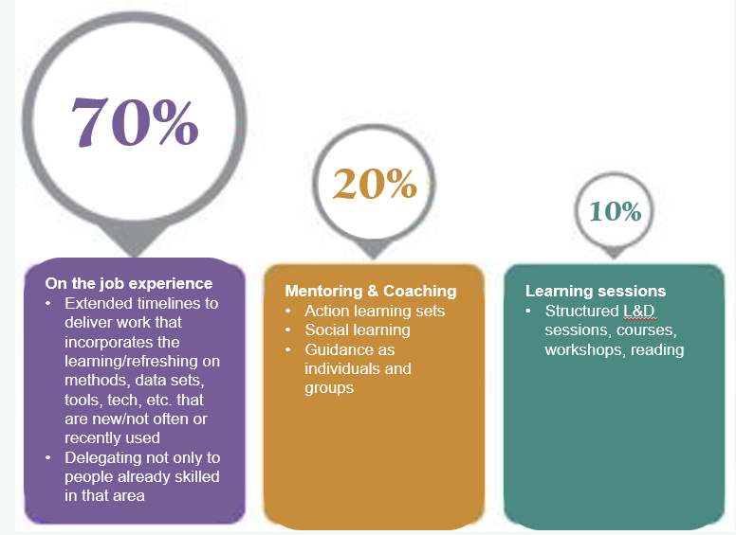
Learning & Development Programme Pillars
Notes:
Hand to Charlotte
The programme enabled everyone in the wider team to develop, within protected L&D time, via structured learning (10%), peer-mentoring(20%) and applying new skills on the job (70%). Each analyst facilitated one learning session each year.
Agree and communicate the core skills profile for the team
Audit cycle: annual baselining of the team’s skills and competencies using the NCF and a more detailed skills audit and then gap analyses
Programme planning: Pillars of competency groupings are led by one member of the team
Learning sessions held every fortnight, facilitated by a non-expert member of the team, or an invited guest
Materials shared in advance to accommodate learning styles
Practical activities included in each session
Feedback gathered and used to improve future programming
Analytical methods include problem definition and problem structuring, data visualisation, statistics, hypothesis testing, etc
Leadership as covered in previous slide
Tech stack (Charlotte to elaborate)

Slide 10



Themes
Everyone getting there together
Protecting learning time while delivering
Sharing the responsibility
Notes:
Charlotte
Everyone getting there together
Easier to ask each other questions, people would set up chats/ learning groups.
Easier to QA work when more complicated analysis is done
Juggling learning and development alongside delivery
70% of learning is being given extra time within an agreed timescale to support the learning of a new skill during delivery.
Sharing the responsibility
All analysts contributed to the overall learning of the team.

Slide 11
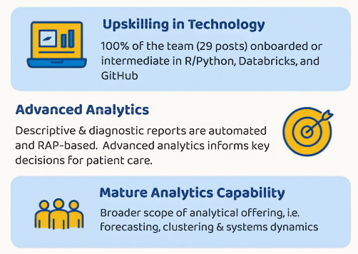
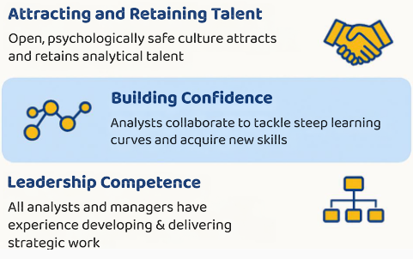
Small Steps, Measurable Impact
Notes:
100% of our team, with 29 posts, have been onboarded or are intermediate users of R/Python, Databricks, and GitHub.
Our analysts have the confidence to tackle steep learning curves together to acquire new skills.
The scope of our analytical offerings is broader.
Descriptive analytics are automated and RAP-based
Deeper-dive advanced forecasting and analytics inform key decisions and support patient care via the region’s programmes supporting providers.
Our approach fosters an open, psychologically safe culture and excellent analyst retention.

Slide 12
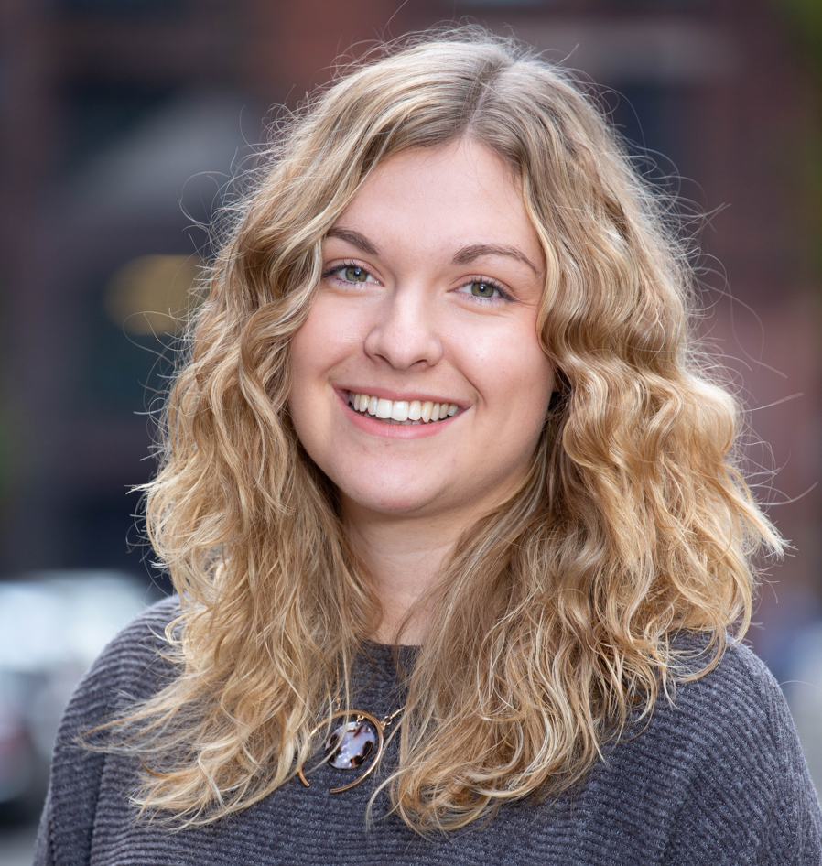
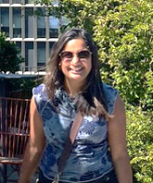
Grace Dean Attracting talent
The team had a strong technical skillset which I knew I'd be able to learn from. [The] learning [programme] and tech tools gave the impression of a well-established team offering plenty of development opportunities.
Impact statements
Dr Suchi Collingwood Psychological safety
What really resonated with me was the inclusive culture to learning – within team meetings time was created for people in the team to present, creating space for diverse ideas and perspectives. There’s a genuine willingness to listen and learn from other points of view.
Notes:
Hand to Keiko

Slide 13
What have we learned?
An overt strategy for learning drives the team forward.
The 70:20:10 approach is effective in developing advanced analytical and leadership skills.
Small actions over time bolster your team.
Facilitators need not be experts. Teaching is learning.
Notes:
Keiko

Slide 14

What action will you take home to use in your team’s learning programme?
Know Delivering on a learning strategy leads to an upskilled, attractive team.
Feel Developing advanced analytical and leadership skills is achievable.
Do Take home small actions to bolster your team.

Slide 15
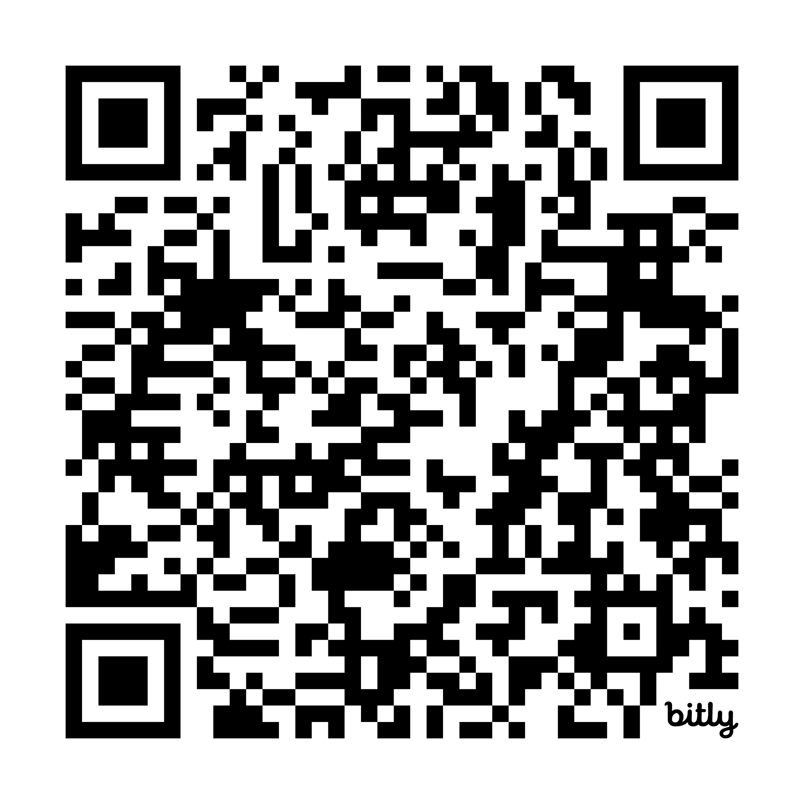
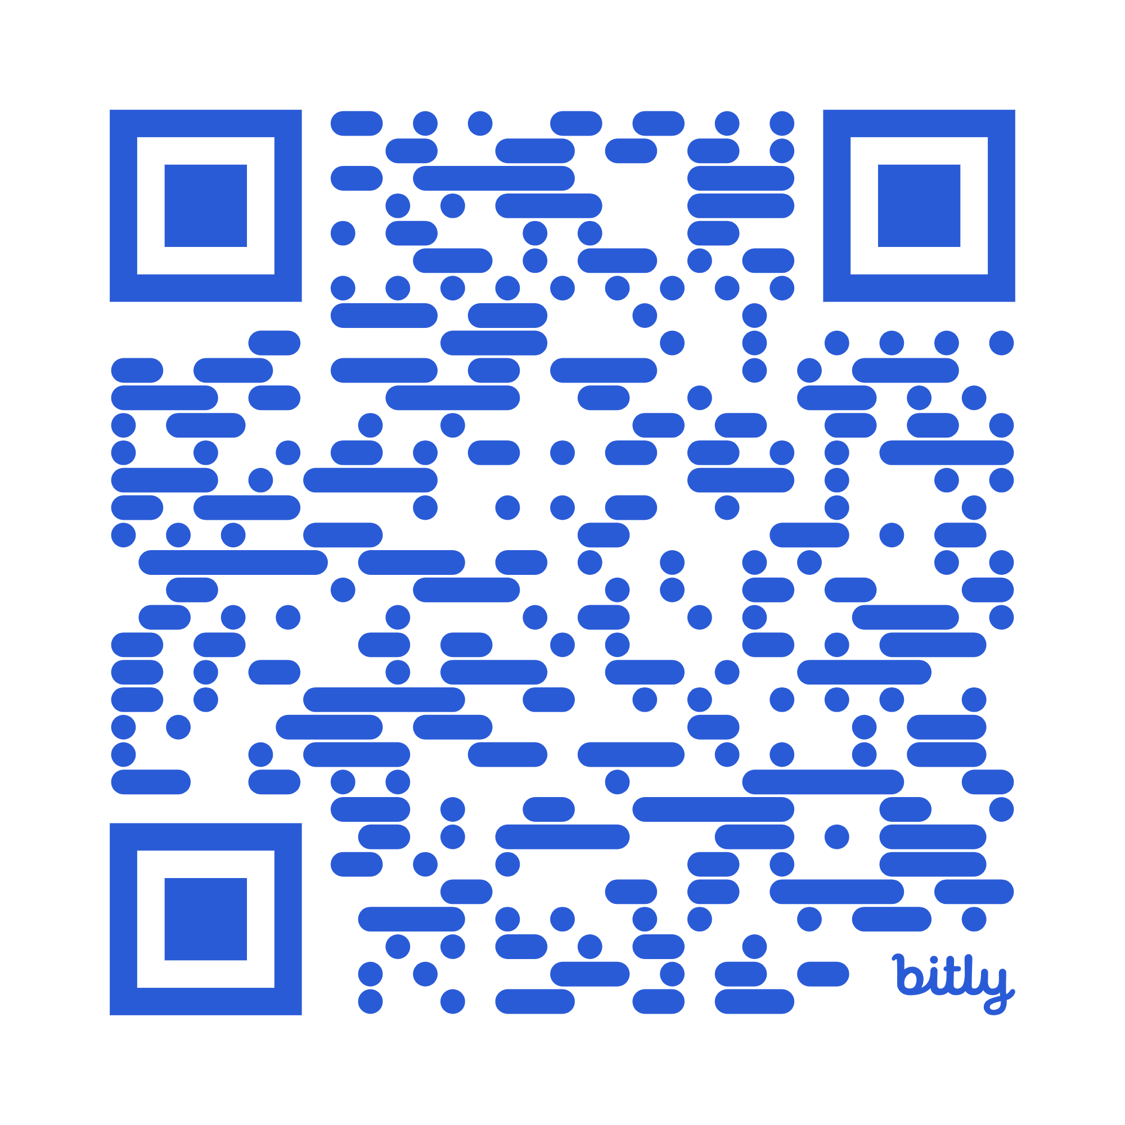



Access our materials
Today’s HACA talk with our playbook and tips for facilitators training your team
Past learning content on NHS Futures for people with @nhs.net accounts

Slide 16
Tips on how to facilitate effective learning sessions
Learning objectives
Design specific can-do statements as objectives.
Identify needs from skills audits and asking people.
Interactive exercises are a must
Draw on real-life experiences/ programme data.
Could be individual or in small groups (max 4 people)
Content
Visuals help convey key messages.
Provide slides/videos/reading prior to the session.
Provide links to examples and further reading.
Feedback form
Ask about both, format and content.
Survey directly after the session and 6 months later to test sustained impact.

Slide 17
Recent learning sessions facilitated by the team
Analytical |  | Leadership |  | Tech Stack |  | Datasets
Quality Assurance |  | Strategy Development |  | GitHub: Collaborating on code |  | Sitreps
Data Quality |  | Influencing and managing stakeholders |  | GitHub & UDAL with R |  | HES/SUS/SUS+/Faster SUS
Storytelling with data |  | New Work Request Template |  | GitHub & DataBricks |  | Faster data flows
Problem Structuring |  | Governance and analytical scoping |  | GitHub: Data Bricks with PySpark |  | ECDS
Stats: Starting from scratch |  | Writing the project brief |  | GitHub: gitignore |  | WLMDS & RTT
Stats: Population vs. sample data insights |  | Programme & business planning |  | Federated Data Platform Tools
Stats: Correlation and causation |  | Project Management Practical Tools |  | SQL beginner to advanced
Stats: Regression approaches |  | Project Management: Prince2 |  | Tableau connections and dashboarding
Evaluation methods |  | Project Management: Agile & Scrum |  | Python basics
AI and Machine Learning |  | Line Manager Training |  | R Series
RAP workshop |  | Effective 1:1s
System Dynamics |  | Giving and Receiving Feedback
Discrete Events Simulation |  | Action Learning Sets
Process Mining |  | National Competency Framework
Data Visualisation |  | Skills Audit
Forecasting methods |  | What makes an effective meeting?

